Slide 1
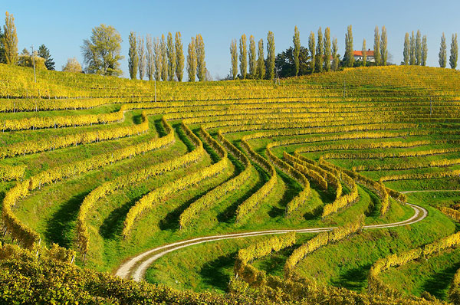
SLOVENIA & WINE
mag. TJAŠA KOS
JARENINA, 2013

Slide 2
SLOVENIAN WINES
love, effort and knowledge as a greater possibility to succeed
natural resources
excellent conditions for the growth and development of the vine in several parts of Slovenia
climate, soil structure and relief
wine experts consider some Slovenian wine-growing areas to be the best in the world

Slide 3
FOR ALL TASTES
on a global scale, Slovenian wines are quite important, special and known for their quality and taste
almost 70% of Slovenian wines fulfill the criteria for quality and premium wines
a result of a highly-developed wine culture and demanding wine lovers
white and red wines
with lush or slight aromas and strong, full or light tastes

Slide 4
FOR ALL TASTES
COLOUR
white wine (around 70%)
red wine
SUGAR CONTENT
from dry to sweet wines
sparkling wine –PENINA
a special pleasure to get to know such wines in the their natural environment – in Slovenian wine-growing regions, their inns, agritourism locations and wine cellars

Slide 5
The history of wine-makinG
the Celts were the first to begin producing wine, approximately 400 years B.C.
wine was kept in oak barrels
Romans in the first century A.D.
expanded wine production and had their own methods of archiving and maturing wine in pottery
Pagan tribes of Slavs in the 6th century
wine production decreased,
while again gaining importance with Christianisation from the 9th century on

Slide 6
The history of wine-makinG
in the 13th century, the authorities ordered the first rights and duties of wine-makers
first manuals for work in vineyards and wine cellars in the 18th century
In the second half of the 19th century, the first agricultural schools in Maribor, Vipava and Novo mesto
the vine louse in 1880 destroyed half of the vineyards
The legislation and rules on the protection of Slovenian wines in the beginning of the 1970's directed winemakers toward the production of quality wines.

Slide 7
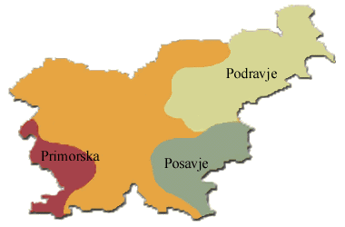
WINE-GROWING REGIONS IN SLOVENIA

Slide 8
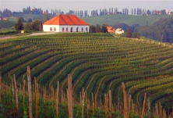
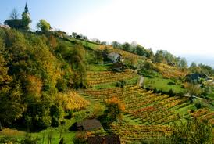
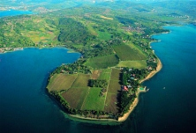
WINE-GROWING REGIONS IN SLOVENIA
wine-growing region
of Podravje
the wine-growing region
of Posavje
wine-growing region
of Primorska

Slide 9
WINE-GROWING REGION of podravje
2 wine-growing districts:
Wine-growing district of Štajerska Slovenija
Wine-growing district of Prekmurje
the largest
in the Eastern part of Slovenia
especially famous for its white wines
mostly popular laški rizling, followed by chardonnay and renski rizling, sauvignon...
modra frankinja, modri pinot
šipon!
wines are full of flavour with rich aroma

Slide 10
WINE-GROWING REGION of podravje
wines are full of flavor with rich aroma
according to sugar content, they belong to all categories – from dry and semi dry to semi sweet and sweet wines
famous for their sweet wines, which receive awards all over the world
wines of premium and high quality
late harvest, selection, berry selection, ice wine, dry berry selection
sparkling wines

Slide 11
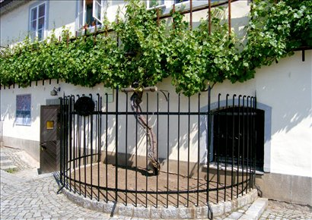
WINE-GROWING REGION of podravje
žametna črnina in Lent in Maribor is 400 years old
the oldest vine in the world that still grows

Slide 12
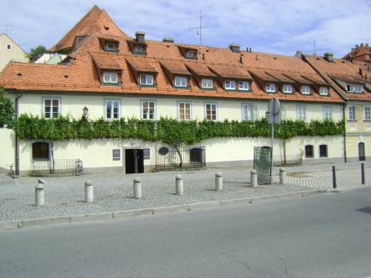
WINE-GROWING REGION of podravje

Slide 13
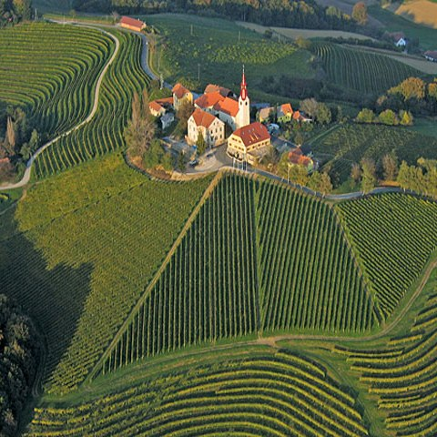
WINE-GROWING REGION of podravje
JERUZALEM
šipon

Slide 14
WINE-GROWING REGION of posavje
3 wine-growing districts:
Bela krajina wine-growing district
The wine-growing district of Dolenjska
The wine-growing district of Bizeljsko-Sremič
the smallest
protected white blend wine cviček (low alcohol content)
Žametna črnina, modra frankinja and modra portugalka ...
chardonnay, sauvignon and laški rizling ...

Slide 15
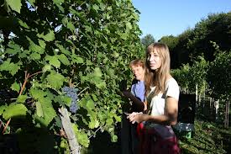
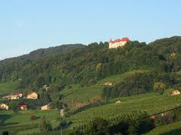
WINE-GROWING REGION of posavje
according to sugar content, they belong to all categories – from dry and semi dry to semi sweet and sweet wines
late harvest, selection, berry selection, ice wine, dry berry selection
sparkling wines

Slide 16
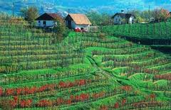
WINE-GROWING REGION of pOSAVJE

Slide 17
WINE-GROWING REGION of pRIMORSKA
4 wine-growing districts:
The wine-growing district of Slovenian Istra
The wine-growing district of Karst
The wine-growing district of Goriška Brda
The wine-growing district the Valley of Vipava
the influence of the Adriatic, mild Mediterranean climate
hot, dry summers and mild winters with a strong bora wind

Slide 18
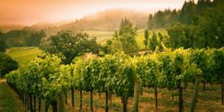
WINE-GROWING REGION of pRIMORSKA
refošk, merlot, barbera, cabernet sauvignon...
chardonnay, malvazija, rebula, sauvignon...
some varieties are autochthonous (zelen, vitovska grganja, pinela)
teran as a specialty

Slide 19
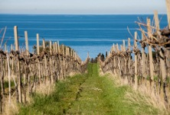
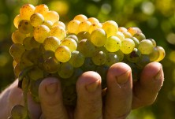
WINE-GROWING REGION of pRIMORSKA

Slide 20
INTERESTING ...
17.500 ha of vineyards
reducing
Slovenian vineyards just 0.5% of all the vineyards in the EU
fragmentation and small vineyards lead to higher production costs
70 % of vineyards age of 25
by age and equal Podravje and Primorska
Posavje with the worst structure, 43% of all vineyards older than 25 years

Slide 21
INTERESTING ...
Number of farms, depending on the size of the vineyard

Slide 22
INTERESTING ...
SIZE OF THE VINEYARD
NUMBER OF VINEYARDS
PERCENTAGE OF VINEYARDS (%)
PERCENTAGE OF WINEPRODUCERS (%)
up to 0,1 ha
5.729
2,38
19,81
0,101 - 0,5 ha
20.774
21,07
57,93
0,501-1 ha
5.966
12,04
10,93
1,001-2 ha
4.815
13,64
6,20
2,001-5 ha
4.320
17,70
3,69
more than 5 ha
3046
33,16
1,43

Slide 23
INTERESTING ...
in the EU is around 10% steep leg in Slovenia is around 70%, as a rule, these are absolute vineyard location, providing the highest quality wines
30,08 % of vineyard is inclined up to 15 %
48,26 % of vineyard is inclined between 16 and 30 %
20,38 % of vineyard is inclined between 31 and 50 %
1,28 % of vineyard is inclined between 51 and 70 %

Slide 24
INTERESTING ...
35.000 wine producers
between 80 and 100 million liters of wine
more than 50 varieties
technological equipment varied, depending on the size, history, traditions, policies, ingenuity and performance
for the most wine producers winemaking is an additional activity
export = import
import of less quality wines (table wines)
export of quality and premium quality wines

Slide 25
INTERESTING ...
1955: 1st international competition and exhibition of wines in Ljubljana
1975: 1st competition and exhibition of wines in Gornja Radgona, today Vino Slovenija
Gornja Radgona
1986: 1st Ljutomer wine queen was also first in former Yugoslavia
1996: 1st Slovenian wine queen

Slide 26
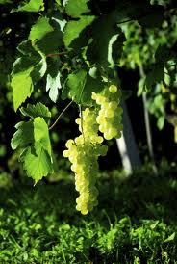
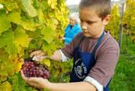
INTERESTING ...
carefully cultivated vineyards
hand picked
quality and premium quality of the wines

Slide 27
INTERESTING - EVENTS
Vintage of the Old Vine
Slovenian Wine Festival in Ljubljana
Salon Jeruzalem
VinDel, international wine and delicatessen salon in Maribor
Praznik rebule
Praznik refoška
Vigred
Night of sparking wine
...

Slide 28
INTERESTING – ST. MARTIN´S DAY
November 11th
people celebrate the name day of St. Martin
according to legend, he turned water into wine
to honor this holiday, many ritual celebrations take place every year during the week surrounding St. Martin’s Day
wine matures at this time
the “impure” and “sinful” must is blessed into real wine
these events are filled with joy, music, local culinary specialties and, naturally, wine

Slide 29
Slovenian wine queen
Slovenian wine queen
Since 1996
competition
promotion of Slovenian wine, wine tourism and also gastronomy
culture of wine drinking

Slide 30
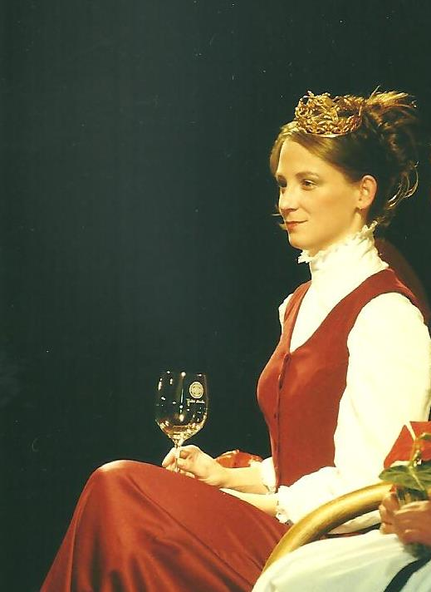
Slovenian wine queen
2013
2002

Slide 31
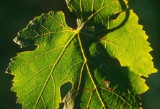
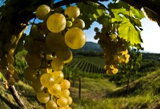
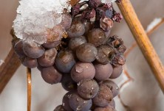
BEAUTIFULL ...

Slide 32
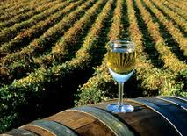
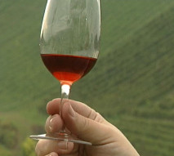
BEAUTIFULL ...

